Slide 1
ビジュアルナビゲーションの
ための画像の対応付け方法
大矢グループ i-ROBOT
Helio Perroni Filho
Notes:
Good morning everyone, I am Helio Perroni Filho and this is my presentation on Image Stream Synchronization for Visual Navigation.

Slide 2
自律走行について「教示・再生」
例示によりロボットに経路を教える
プログラミングより簡単
訓練されているオペレータは要らない
出
発
点
オペレータ
目
的
地
「教示」ステップ
（人が経路上を操作）
1.
ロボット
2.
「再生」ステップ
（自律走行）
ロボット
Notes:
Currently there is great interest in more intuitive man-machine interfaces for robotics systems, especially robots that can be configured by example, rather than direct programming. The appeal is that robots can then be configured by unskilled operators. This s called teach-replay.
For example, let's say we have an office courier robot to carry documents or supplies from one room to another. If our robot can do teach-replay, first we guide it through the route (what we call the “teach step”),and later, using information gathered along the route, the robot will retrace it autonomously (the “replay step”).

Slide 3
自律走行について「教示・再生」
視覚に基づく自律走行
カメラを使うのは色々な利点が有る：
  ロバスト
  コスト効率が良い
  手に入り易い
  人間に直感的
画像
（「再生」ステップ）
目印
経路修正
「再生」ステップ
画像
（「教示」ステップ）
ドリフト
「教示」ステップ
Notes:
A lot of work has been done on teach-replay, especially using cameras as sensors. Cameras have many advantages over other kinds of sensors: they are robust, cost-effective, ubiquitous and intuitive to humans.
Work in visual teach-replay navigation has often focused on appearance-based navigation, which uses differences in the appearance of selected landmarks to estimate differences in robot location between teach and replay paths, and effect corrections if necessary.

Slide 4
自律走行について「教示・再生」
DiVS:左右ドリフ認識
ドリフ
再生の画像に対応する教示の画像を得るか？
「再生」ステップ
「教示」ステップ
Notes:
In my previous research I worked on recognizing lateral drift, that is, whether the robot is straying from the teach path either to the left or right. However as a robot retraces a taught path it may also incur longitudinal drift, that is it may trail behind or skip ahead relative to the position predicted by the teach record. This second form of drift is the subject of this presentation.
If for each replay image we could reliably determine the teach image of closest viewpoint (that is, the location from which each image was taken), then longitudinal drift could be easily detected. This would also have important implications for lateral drift detection, since the smallest the viewpoint difference between teach and replay images, the more reliably can direction differences be detected.

Slide 5
自律走行について「教示・再生」
対応画像の探索の参考文献
方法 | 参照 | センサ | 環境 | 変化
 |  |  |  | 照明 | 隠蔽 | 動物体
テンプレート照合 | [5] | 単眼カメラ | 屋内 | × | × | ×
コスト関数の最適化 | [6] | 単眼カメラ | 屋内 | × | × | ×
相互情報量 | [7] | 単眼カメラ | 屋内 | × | ○ | ○
特徴点の追跡 | [8] | 単眼カメラ | 屋内・屋外 | ○ | × | ○
局所最大の相性 | [9] | 単眼カメラ | 屋外 | ○ | ○ | ○
ステレオ特徴点の マッチング | [10] | ステレオカメラ | 屋内 | ○ | ○ | ○
平均ランドマーク ベクトル | [11] | パノラマ式カメラ | 屋内 | ○ | × | ×
オプティカル・フロー | [12] | パノラマ式カメラ | 屋内 | ○ | ○ | ×
本研究 |  | 単眼カメラ | 屋内・屋外 | ○ | ○ | ○
Notes:
Here I show some of the image pairing methods that have been proposed over the years – you can find the respective articles on my report's bibliography, these are their reference numbers.
Most of these methods deal with computing a representation that is consistent across image variations, but fall short one way or another. A common limitation is for a method to only work indoors or outdoors. Difficulties on dealing with moving elements, such as people, or occlusions are also common. Some methods also require non-standard hardware, such as stereo cameras.
Therefore, there is still demand for an image pairing method that works well indoors and outdoors, uses simple hardware such as a single monocular camera, and can deal with changes in lighting and the presence of occlusion and moving objects.

Slide 6
自律走行について「教示・再生」
対応画像の探索
本研究：「特徴点の相互相関」
画像シーケンスから安定な対応を作る
カメラ校正は要らない
照明変化・隠蔽面・動物体にロバスト
屋内も屋外も使える
Notes:
The limitations of current image pairing methods have motivated me to look for a new solution, which I call feature point correlation.
It works on image sequences, generating stable representations that are robust to changes in lighting, occlusions and the presence of moving elements. It is applicable to indoors and outdoors environments, requiring a single, uncalibrated monocular camera as input.

Slide 7
目次
自律走行について「教示・再生」
特徴点の相互相関による対応画像の発見
実験結果
まとめ
Notes:
The feature point correlation method and its application to teach-replay are the subjects of the remainder of this presentation.
In the next section I describe the method. Then I show experimental results that demonstrate the method's performance both indoors and outdoors. Finally I discuss directions for further research.

Slide 8
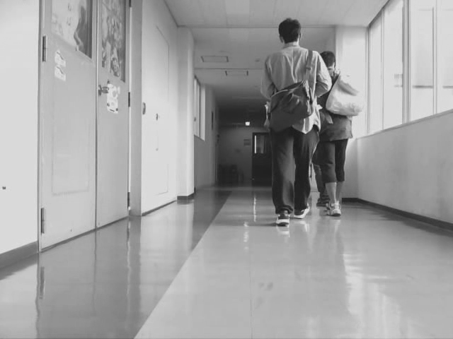
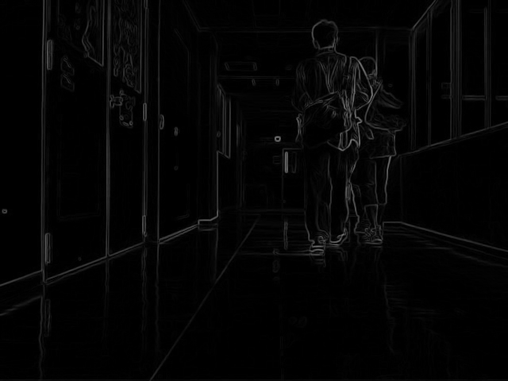
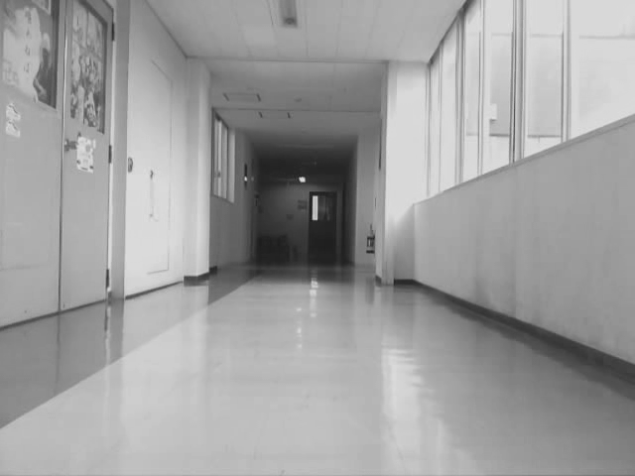
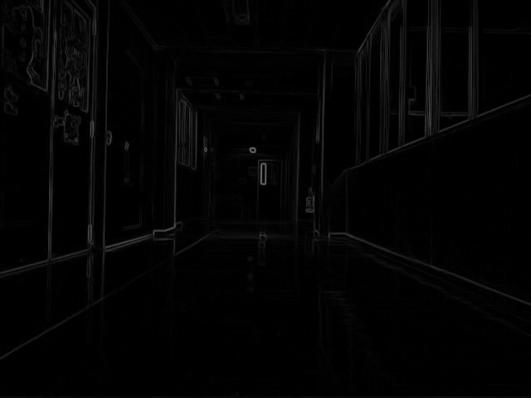
特徴点の相互相関
「再生」画像I'j
「再生」マップH'j
p'j,k
c'j,k
P(z, H'j) = [p'j,1, ..., p'j,z]
p'j,k = (xj,k, yj,k)
C'j = [c'j,1,... , c'j,z]
c'j,k = H'j[p'j,k - α : p'j,k + α]
η
p'j,k
ci,j,k
η
Ci,j = [ci,j,1,... , ci,j,z]
ci,j,k = Hi[p'j,k - β : p'j,k + β]
「教示」画像シーケンス
St = [I1, ..., Im]
「教示」マップHi

Slide 9
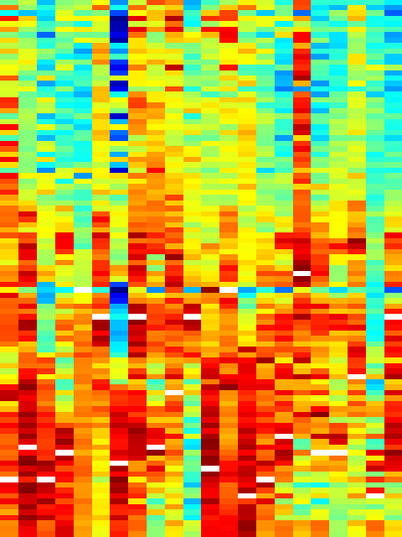
特徴点の相互相関
qi,k = max(ci,j,k ⭑ c'j,k)
ci,j,kはc'j,kの
ベストマッチ
C1,j
...
0
...
4
…
3
…
[C1,j, ..., C1,j,m]
Ci,j = [ci,j,1,... , ci,j,z]
=
count
^{k}
Ci,j
C'j = [c'j,1,... , c'j,z]
Cm,j
c'j,1
c'j,k
c'j,z
Notes:
Given a sequence of gray-scale images, the changes between successive images can be represented by the pixel-by-pixel absolute differences between them. The darker regions of such difference images show where the two images are very similar to each other, and the brighter regions, where they are different. This separation between “change” and “no change” regions can be enhanced by the application of a thresholding operation, such as Otsu's method.
These thresholded difference images provide representations stable to lighting changes, but they are still affected by occlusions and moving elements. In order to account for that, we smooth out such transient changes by calculating the average over a sequence of difference images.
These are what I call differential images, they show the amount of change in different regions of the visual field over a sequence window of some size w. Brighter pixels show high amounts of change, and darker ones, low amounts.

Slide 10
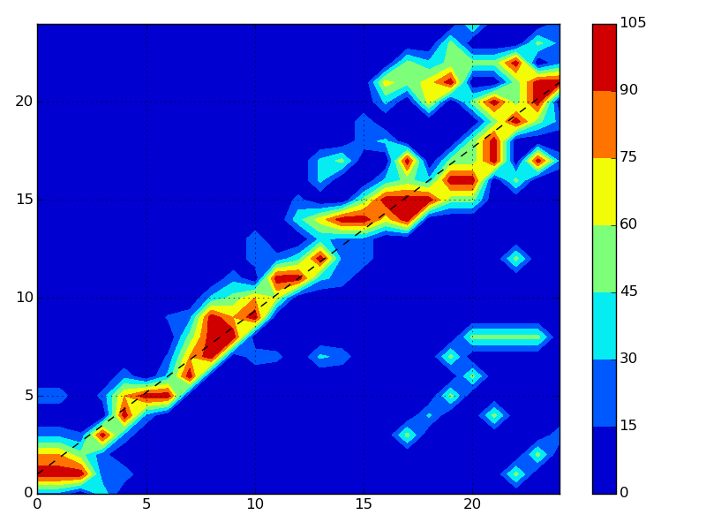
特徴点の相互相関
...
0
...
2
…
3
…
...
0
...
4
…
3
…
...
4
...
2
…
0
…
...
...
Ii
「教示」画像のインデックス
「再生」画像のインデックス
I'j
I'1
I'j
I'n
Notes:
Given a sequence of gray-scale images, the changes between successive images can be represented by the pixel-by-pixel absolute differences between them. The darker regions of such difference images show where the two images are very similar to each other, and the brighter regions, where they are different. This separation between “change” and “no change” regions can be enhanced by the application of a thresholding operation, such as Otsu's method.
These thresholded difference images provide representations stable to lighting changes, but they are still affected by occlusions and moving elements. In order to account for that, we smooth out such transient changes by calculating the average over a sequence of difference images.
These are what I call differential images, they show the amount of change in different regions of the visual field over a sequence window of some size w. Brighter pixels show high amounts of change, and darker ones, low amounts.

Slide 11
目次
自律走行について「教示・再生」
特徴点の相互相関による対応画像の発見
実験結果
まとめ
Notes:
The DiVS method and its application to teach-replay are the subjects of the remainder of this presentation.
In the next section I describe the DiVS method. Then I show how it can be used to implement a teach-replay control module for a mobile robot.
Next I show the results of a number of experiments made with the control module, what conclusions can be drawn from those results, and discuss directions for further research.

Slide 12
実験結果
システムパラメーター
  並進速度 v = 0.3m/s
  画像サイズ640x320、入力周波数1Hz（毎秒1画像）
  推定に用いる画像シーケンス の数m = n = 25
  パラメーター(α, β, z) = (30, 90, 10)
実験環境・経路
「屋外」実験
「屋内」実験
「教示」ステップ
「再生」ステップ
2°
「再生」ステップ
-2°
「教示」ステップ
20m
15m
Notes:
All field test procedures were performed under the same system parameters as shown here.
During teach and replay steps I record odometry to provide an approximation for the robot's true location. Despite its limitations it is good enough for the scale of these tests.
Teach step paths were just straight paths from the start point, with a length of 10 meters. Several teach paths were recorded. Starting from a common initial pose, the robot would make an initial in-place turn of up to 10°, and then set off in a straight line.

Slide 13
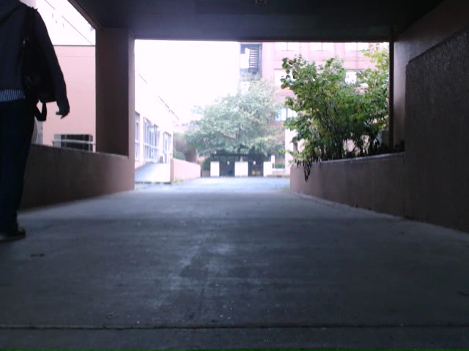
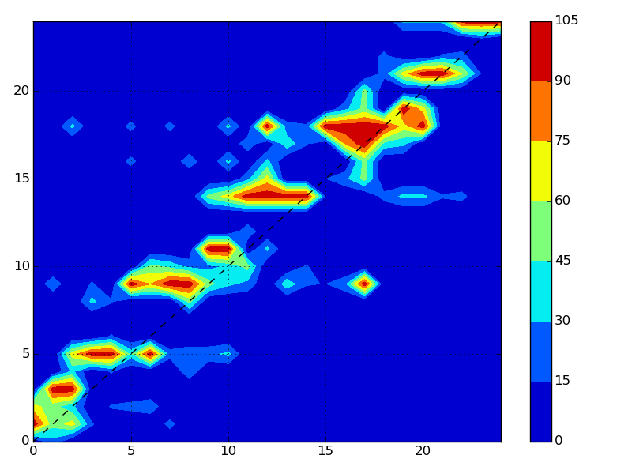
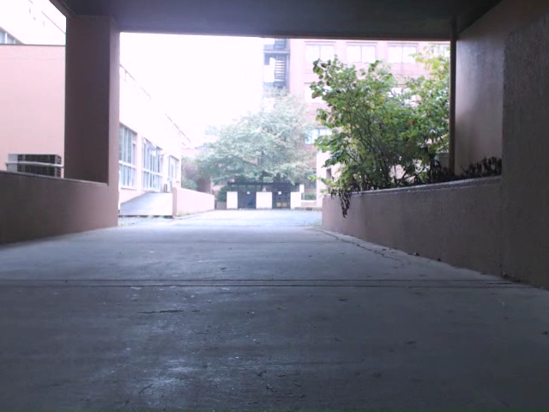
実験結果
「屋外」実験
教示
「教示」画像のインデックス
再生
「再生」画像のインデックス
ほぼ良い結果
Notes:
Despite the differences in visual conditions and the presence of a moving element for much of the test record, the computed shifts for the 0° case either zero or negligible, correctly indicating the robot is treading much the same path as in the reference record.
Results were very good for the 5° drift cases too: shift direction agrees with drift's, and numerical values are consistent.
By the way, the time my implementation took to generate a single DiVS image on my lab notebook was 0.04 seconds on average.

Slide 14
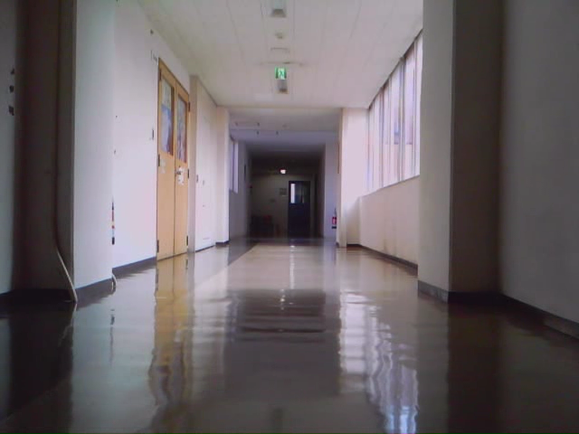
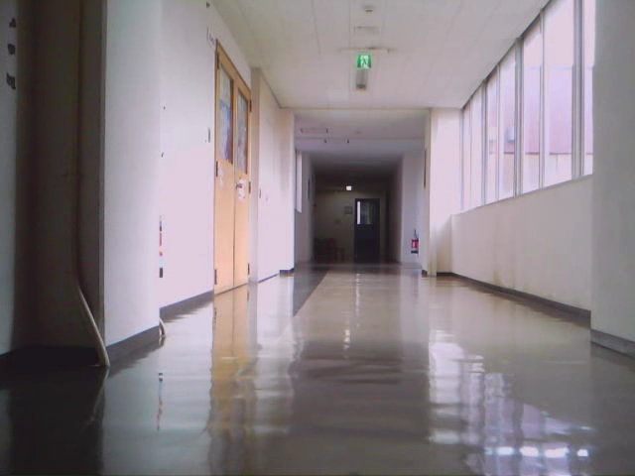
実験結果
「室内」実験
教示
「教示」画像のインデックス
再生
「再生」画像のインデックス
良い結果
画像シーケンスの不対応は少ない
Notes:
Despite the differences in visual conditions and the presence of a moving element for much of the test record, the computed shifts for the 0° case either zero or negligible, correctly indicating the robot is treading much the same path as in the reference record.
Results were very good for the 5° drift cases too: shift direction agrees with drift's, and numerical values are consistent.
By the way, the time my implementation took to generate a single DiVS image on my lab notebook was 0.04 seconds on average.

Slide 15
目次
自律走行について「教示・再生」
特徴点の相互相関による対応画像の発見
実験結果
まとめ
Notes:
The DiVS method and its application to teach-replay are the subjects of the remainder of this presentation.
In the next section I describe the DiVS method. Then I show how it can be used to implement a teach-replay control module for a mobile robot.
Next I show the results of a number of experiments made with the control module, what conclusions can be drawn from those results, and discuss directions for further research.

Slide 16
まとめ
特徴点の相互相関は画像シーケンスから対応を作る
対応は安定、環境の変化にロバスト
今後の予定
  さらに実験
  パフォーマンス向上
  他の線フィッティング方法をやってみる（例：RANSAC）

Slide 17
終わり
以上
Notes:
This is the end of my presentation. Any questions?

